Slide 1


Software Engineering Report
Gaurang Tyagi : 21058570017
Ravish Ranjan : 21058570040
Rishi Mahajan : 21058570043
Shivang Shukla : 21058570054

Slide 2
abstract
A Software has to be developed that not only allows you to plan your day but also provides you feedback on how productive you were throughout the day, week or month.
‘Noteffy’ solves this problem by providing following functionalities:
Note: It allows the user to quickly note down anything important anytime he/she wants.
Tasks: It allows the users to plan their day ahead of time. It also allows the users to set an alarm for the task and receive a notification at the right time.
To-do: Tasks for the current day are converted into a checklist so that the user can mark the tasks as they are completed.
Kudos: This function gives the user a graphical representation of how many tasks were completed by the user in a month and helps the user keep track of their productivity.

Slide 3
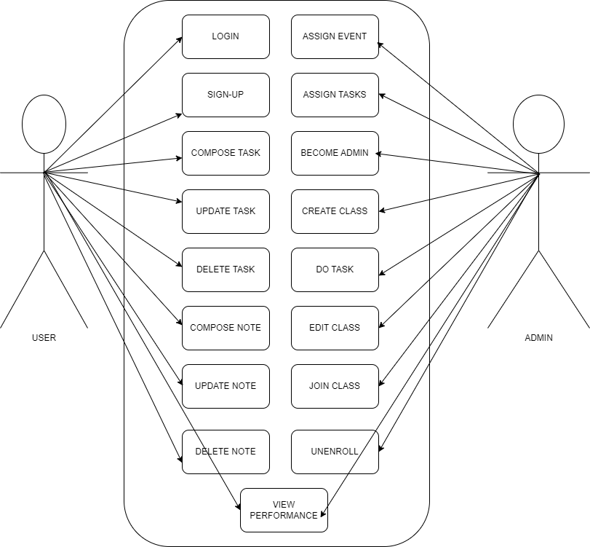
Use case diagram
A use case in software and systems engineering is a list of actions or event steps, typically defining the interactions between a role (known in the Unified Modelling Language as an actor) and a system to achieve a goal. The actor can be a human, an external system, or a time. In systems engineering, use cases are used higher than software engineering, often representing missions or stakeholder goals. Another use case that describes how a real-world actor interacts with the system is another way to look at it. In a system use case, we include high-level implementation decisions.

Slide 4
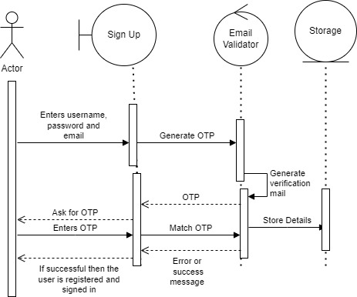
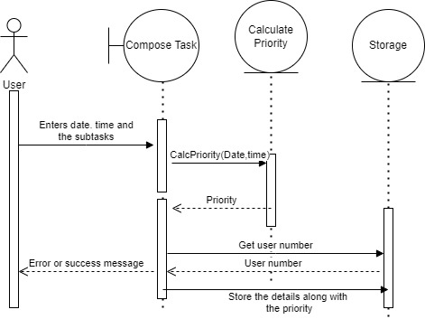
Sequence Diagram
1.) SIGN-UP :
2.) COMPOSE TASK :

Slide 5
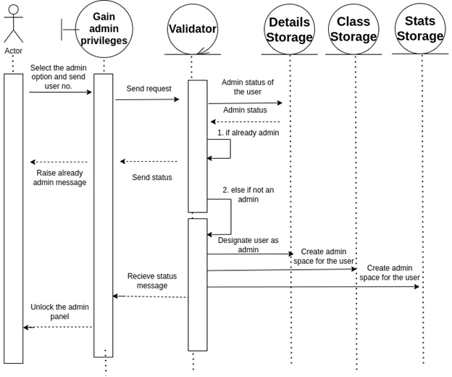
Admin Assign task

Slide 6
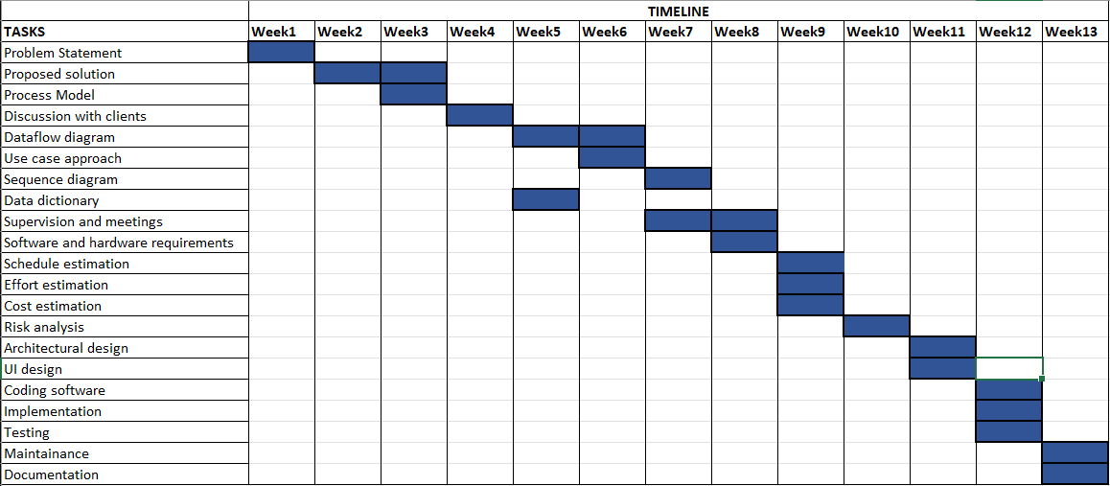
3.1) Timeline Charts

Slide 7
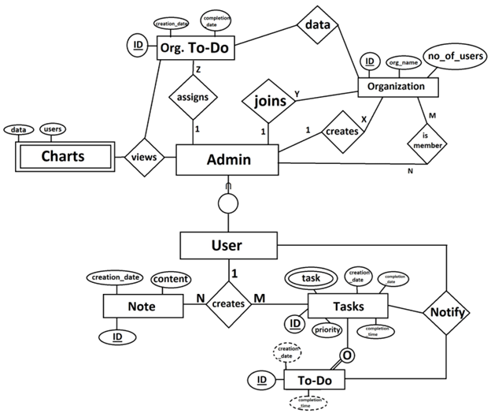
Logical Database Requirements

Slide 8
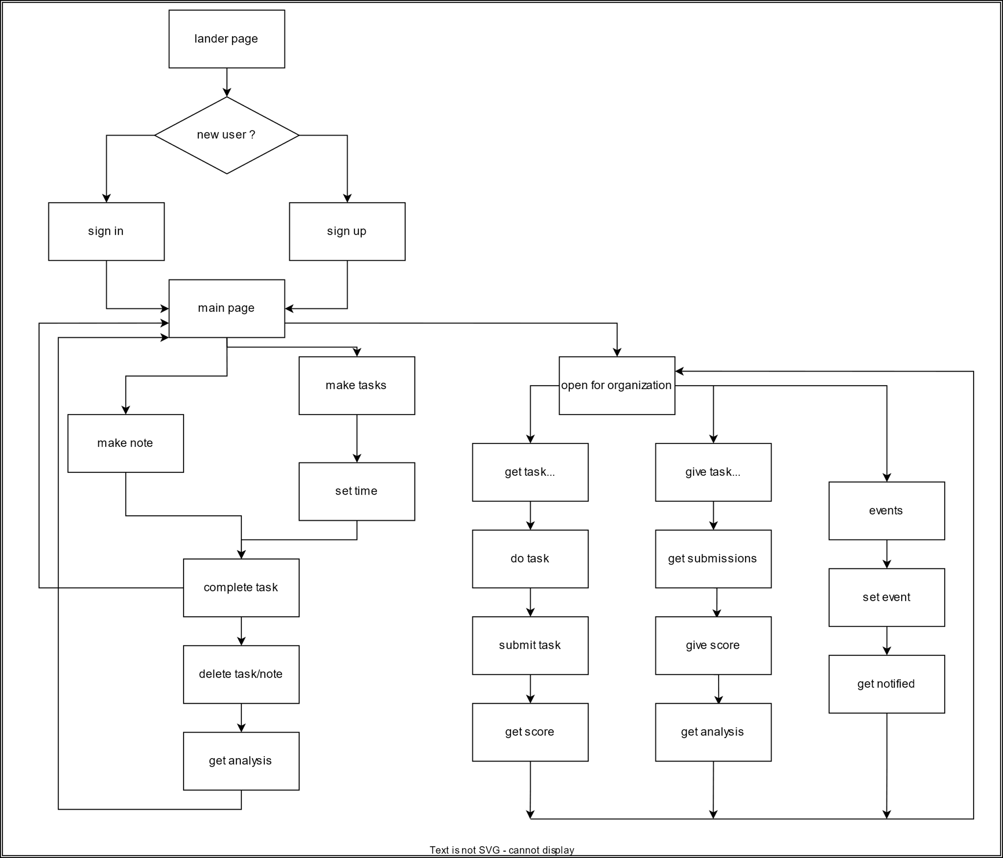
User interaction Flow chart

Slide 9
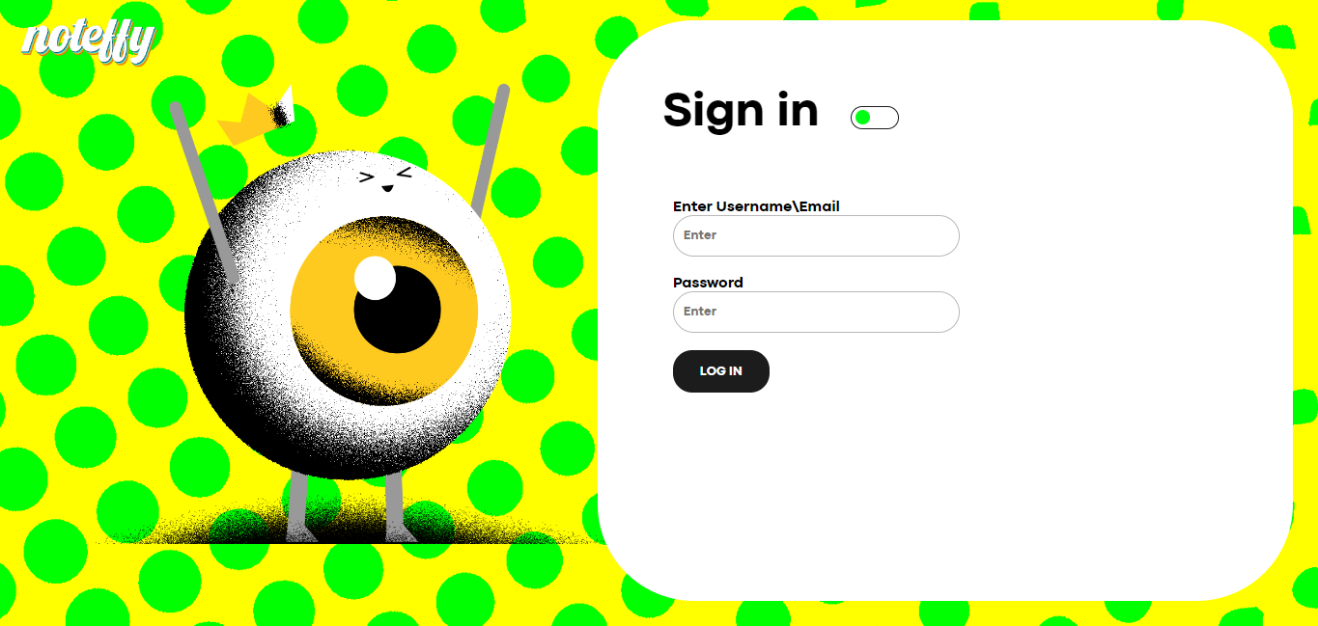
screenshots

Slide 10
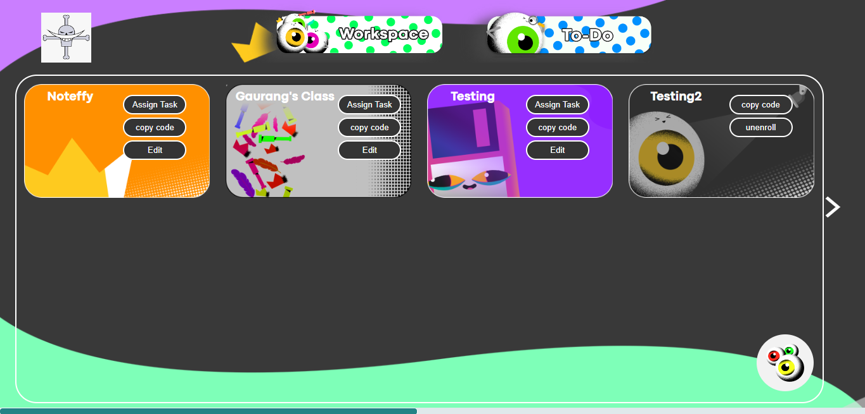

Slide 11


Slide 12
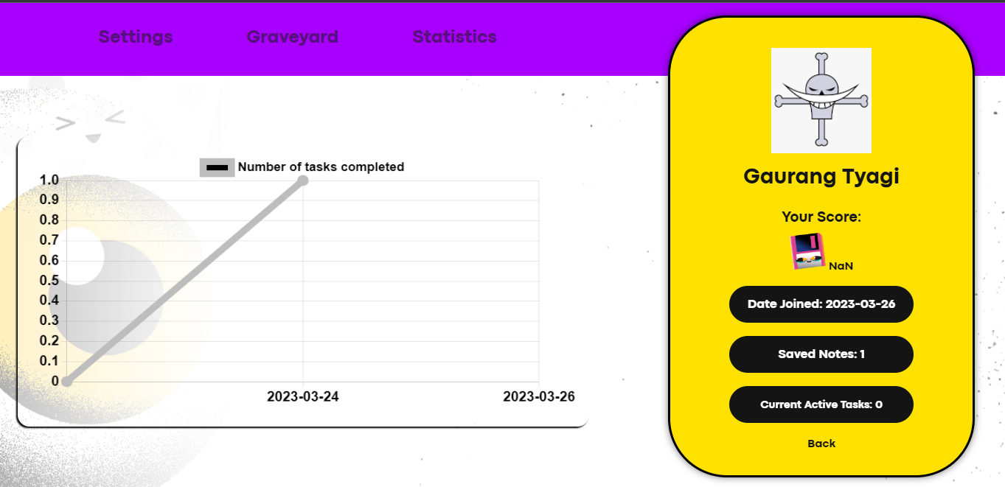

Slide 13
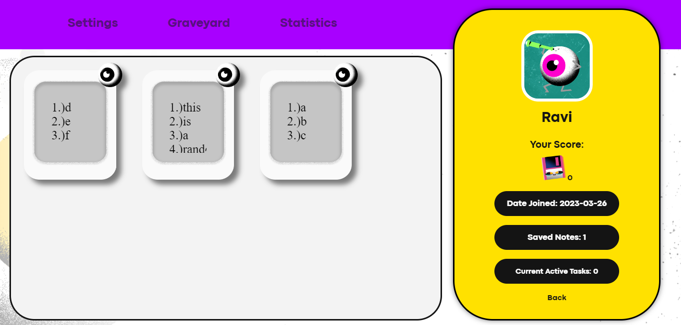

Slide 14
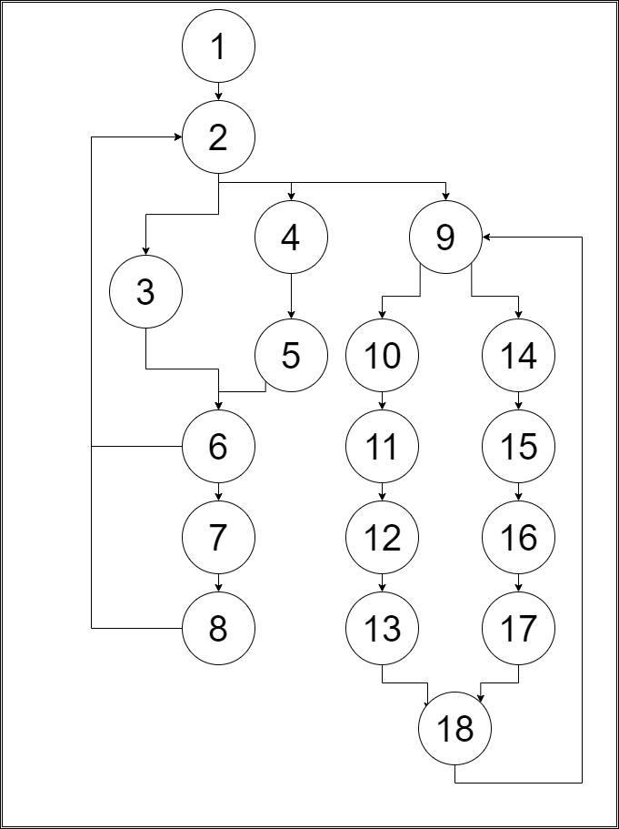
Test case
Cyclomatic Complexity
Here, E = 22, N = 18
Cyclomatic Complexity = 22 – 18 + 2 = 6
Since the cyclomatic complexity is 6, therefore the number of independent paths will be 6.
Independent Paths
Path A: 1 > 2 > 3 > 6 > 2
Path B: 1 > 2 > 4 > 5 > 6 > 2
Path C: 1 > 2 > 3 > 6 > 7 > 8 > 2
Path D: 1 > 2 > 4 > 5 > 6 > 7 > 8 > 2
Path E: 1 > 2 > 9 > 10 > 11 > 12 > 13 > 18 > 9
Path F: 1 > 2 > 9 > 14 > 15 > 16 > 17 > 18 > 9

Slide 15
Data dictionary
2.6 Data Dictionary
A data dictionary collects the names, definitions, and attributes for data elements and models. The data in a data dictionary is the metadata about the database. These elements are then used as a database, research project, or information system.
The data dictionary contains information about the following –
Names of all the database tables and their schemas.
Details about all the tables in the database, such as their owners, their security constraints and when they were created.
Physical information about the tables, such as where they are stored and how.
Table constraints such as primary key attributes, foreign key information, etc.
Information about the visible database views.

Slide 16
Field Name | Data Type | Field Size | Description
User Name | VARCHAR | 12 | unique identity of user
Account Password | VARCHAR | 16 | user authentication field
User Email | VARCHAR | 24 | contact detail of user
Note | VARCHAR |  | Note(s) of user
Note date | DATE | 10 | date of construction of note
Task | VARCHAR |  | Task(s) of user
Task date-time | DATE | 10 | date of construction of task
Task priority | INTEGER | 1 | identifier for the urgency of task
Count of completed tasks | INTEGER | 3 | record of task which are completed
Count of zombie tasks | INTEGER | 3 | record of task which are not completed
Zombie Tasks | VARCHAR |  | record of task which were not completed but the completion time is passed
Profile Picture | VARCHAR | 4 | type of profile pic user have chosen to be displayed for him
Org. Code | VARCHAR | 10 | unique identity of an organization used to join users to the organization
Org.Name | VARCHAR | 12 | name of the organization
Org. Description | VARCHAR | 24 | description/about info of the organization
Org. Tasks | VARCHAR |  | tasks asigned my organization of its members
User Role | BOOLEAN | 1 | role of user to determine whether to unlock the organization service or not
Completed Tasks | INTEGER | 2 | record of organization members' completed tasks

Slide 17
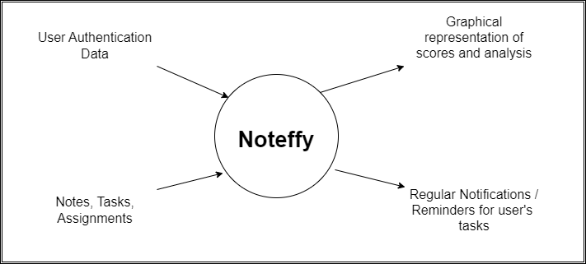
Data flow diagram
Level-0 Data flow diagram of Noteffy
It is also known as the fundamental system model, or context diagram represents the entire software requirement as a single bubble with input and output data denoted by incoming and outgoing arrows.

Slide 18
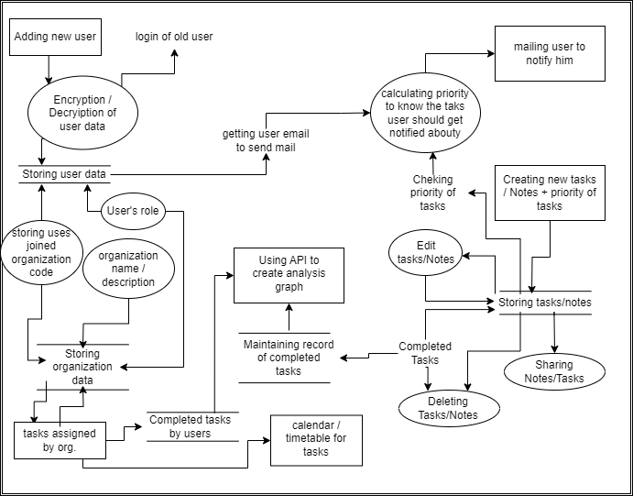
Level-1 Data flow diagram of Noteffy
In 1-level DFD, a context diagram is decomposed into multiple bubbles/processes. At this level, we highlight the system's main objectives and break down the high-level process of 0-level DFD into subprocesses.

Slide 19
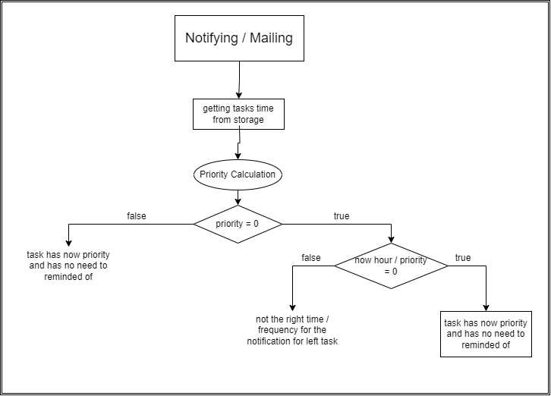
Level-2 Data flow diagram of Noteffy
2-level DFD goes one process deeper into parts of 1-level DFD. It can be used to project or record the specific/necessary details about the system’s functioning.

Slide 20
Functional Point Estimation
Question | VAFs
Does the system require reliable backup and recovery? | 5
Are specialised data communications required to transfer information to or from the application? | 2
Are there distributed processing functions? | 0
Is performance critical? | 3
Will the system run in an existing , heavily utilised operational environment? | 3
Does the system require online data entry? | 4
Does the online data entry require the input transaction to be built over multiple screens or operations? | 0
Are the ILFs updated online? | 0
Are the inputs, outputs, files or enquiries complex? | 3
Is the internal processing complex? | 3
Is the code designed to be reusable? | 4
Are conversions and installations included in the design? | 0
Is the system designed for multiple installations in different organisations? | 0
Is the application designed to facilitate change and ease of use by the user? | 5
1) Software Project Management

Slide 21
Value Adjustment Factor = Σfi = 32
Now,
Complexity Adjustment Factor (CAF) = 0.65 + (0.01 * ∑fi) => 0.65 + (0.01 * 32) => 0.65 + 0.32
=> 0.97
Functional Units |  | Weighing Factors
 | Count | Simple | Average | Complex
External Inputs | 3 | 3 | 4 | 6
External Outputs | 4 | 4 | 5 | 7
External Enquiries | 3 | 3 | 4 | 6
Internal Logical files | 3 | 7 | 10 | 15
External Interface Files | 2 | 5 | 7 | 10
Unadjusted Function Point (UFP) = 3*6 + 4*4 + 3*4 + 3*10 + 2*5
=> 18+16+12+30+10
=> 86
Now,
Function Point = UFP * CAF = 86 * 0.97
=> 83.42 ~ 84

Slide 22
conclusion
Noteffy is able to achieve all of its goals, namely being a flexible, versatile application that can serve both professional and personal productivity needs while also being robust enough to support specialized use cases across all its user groups.
Future endeavors for Noteffy is to make such a productivity based apps that will also help to connect individuals through a credit-networking sub- system, & in that process to produce new use cases.

Slide 23
bibliography
Software Engineering: A Practitioner’s Approach. 8th edition. McGraw-Hill
https://docs.python.org/3/
Aggarwal, K. K., & Singh, Y. (2007). Software Engineering. 3rd edition. New Age International Publishers.
https://www.php.net/docs.php
https://developer.mozilla.org/
https://github.com/Ravish-Ranjan/Noteffy (Source Code)

